Slide 1
Database Management System (DBMS)
DBMS contains information about a particular enterprise
Collection of interrelated data
Set of programs to access the data
An environment that is both convenient and efficient to use
Database Applications:
Airlines: reservations, schedules
Universities: registration, grades
Sales: customers, products, purchases, order tracking
Employee records, salaries, ……
Databases touch all aspects of our lives

Slide 2
University Database Example
Application program examples
Add new students, instructors, and courses
Register students for courses, and generate class rosters
Assign grades to students, compute grade point averages (GPA) and generate transcripts
Clicker data: record attendance and quiz answers
Quiz Q1: Click 1 now!
In the early days, database applications were built directly on top of file systems

Slide 3
Purpose of Database Systems
Drawbacks of using file systems to store data:
Data redundancy and inconsistency
Multiple file formats, duplication of information in different files
Difficulty in accessing data
Need to write a new program to carry out each new task
Data isolation — multiple files and formats
Integrity problems
Integrity constraints (e.g. “dept_name of student must be a valid department name”) become “buried” in program code rather than being stated explicitly
Hard to add new constraints or change existing ones

Slide 4
Purpose of Database Systems (Cont.)
Drawbacks of using file systems (cont.)
Atomicity of updates
Failures may leave database in an inconsistent state with partial updates carried out
Example: Transfer of funds from one account to another should either complete or not happen at all
Concurrent access by multiple users
Concurrent accessed needed for performance
Uncontrolled concurrent accesses can lead to inconsistencies
Example: Two people reading a balance (say 100) and updating it by withdrawing money (say 50 each) at the same time
Security problems
Hard to provide user access to some, but not all, data
Database systems offer solutions to all the above problems

Slide 5
History of Database Systems
1950s and early 1960s:
Data processing using magnetic tapes for storage
Tapes provide only sequential access
Punched cards for input
Late 1960s and 1970s:
Hard disks allow direct access to data
Network and hierarchical data models in widespread use
Ted Codd defines the relational data model
Would win the ACM Turing Award for this work
IBM Research begins System R prototype
UC Berkeley begins Ingres prototype
High-performance (for the era) transaction processing

Slide 6
History (cont.)
1980s:
Research relational prototypes evolve into commercial systems
SQL becomes industrial standard
Parallel and distributed database systems
Object-oriented database systems
1990s:
Large decision support and data-mining applications
Large multi-terabyte parallel data warehouses
Emergence of Web commerce
Early 2000s:
XML and XQuery standards
Automated database administration
Later 2000s: Big Data
massively parallel storage systems
Google BigTable, Yahoo PNuts, Amazon, ..
Parallel data analysis, using MapReduce

Slide 7
Levels of Abstraction
Physical level: describes how a record (e.g., customer) is stored.
Logical level: describes data stored in database, and the relationships among the data.
type instructor = record
ID : string; name : string; dept_name : string; salary : integer;
end;
View level: application programs hide details of data types. Views can also hide information (such as an employee’s salary) for security purposes.
Notes:
7

Slide 8
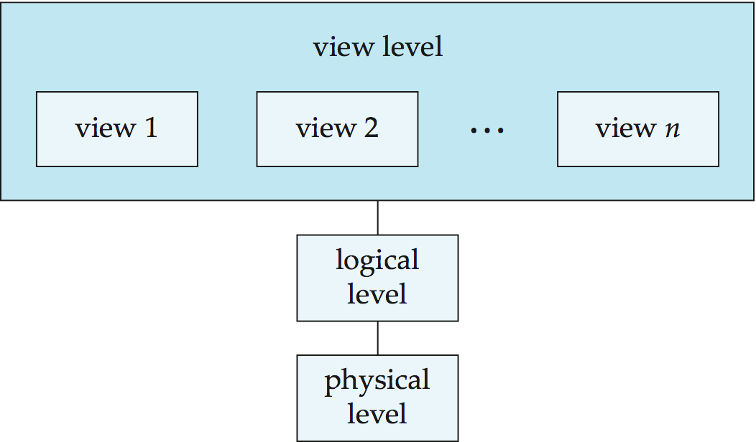
View of Data
An architecture for a database system
Notes:
8

Slide 9
Instances and Schemas
Similar to types and variables in programming languages
Schema – the logical structure of the database
Analogous to type information of a variable in a program
Physical schema: database design at the physical level
E.g. data storage structures, indices for fast access
Logical schema: database design at the logical level
Instance – the actual content of the database at a particular point in time
Analogous to the value of a variable
Physical Data Independence – the ability to modify the physical schema without changing the logical schema
Applications depend on the logical schema

Slide 10
Data Models
A collection of tools for describing
Data
Data relationships
Data semantics
Data constraints
Relational model
Entity-Relationship data model (mainly for database design)
Object-based data models (Object-oriented and Object-relational)
Semistructured data model (XML)
Other older models:
Network model
Hierarchical model

Slide 11
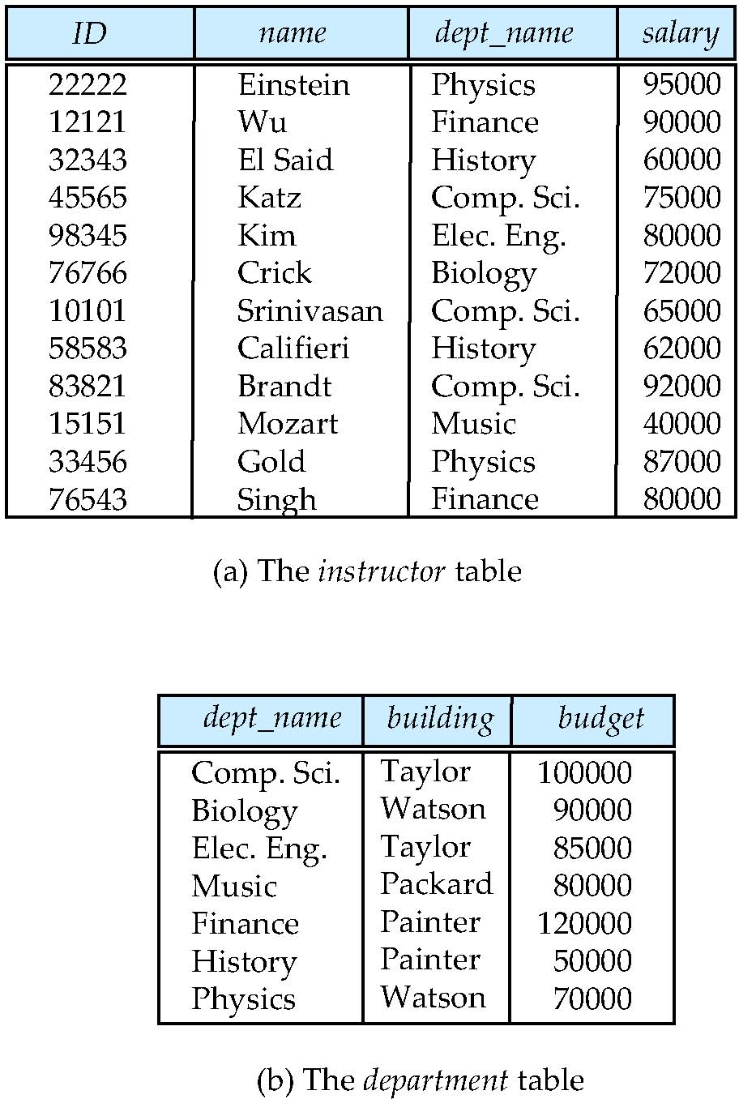
Relational Model
Relational model
Example of tabular data in the relational model
Columns
Rows

Slide 12
A Sample Relational Database
instructor
department

Slide 13
Data Manipulation Language (DML)
Language for accessing and manipulating the data organized by the appropriate data model
DML also known as query language
Two classes of languages
Procedural – user specifies what data is required and how to get those data
Declarative (nonprocedural) – user specifies what data is required without specifying how to get those data
SQL is the most widely used query language

Slide 14
Data Definition Language (DDL)
Specification notation for defining the database schema
Example: create table instructor ( ID char(5), name varchar(20), dept_name varchar(20), salary numeric(8,2))
DDL compiler generates a set of tables
Data dictionary contains metadata (i.e., data about data)
Database schema
Which tables are present, what are their attributes, …
Integrity constraints
Which attributes are primary keys, foreign keys, …

Slide 15
Database Design
The process of designing the general structure of the database:
Logical Design – Deciding on the database schema. Database design requires that we find a “good” collection of relation schemas.
Business decision – What attributes should we record in the database?
Computer Science decision – What relation schemas should we have and how should the attributes be distributed among the various relation schemas?
Physical Design – Deciding on the physical layout of the database

Slide 16
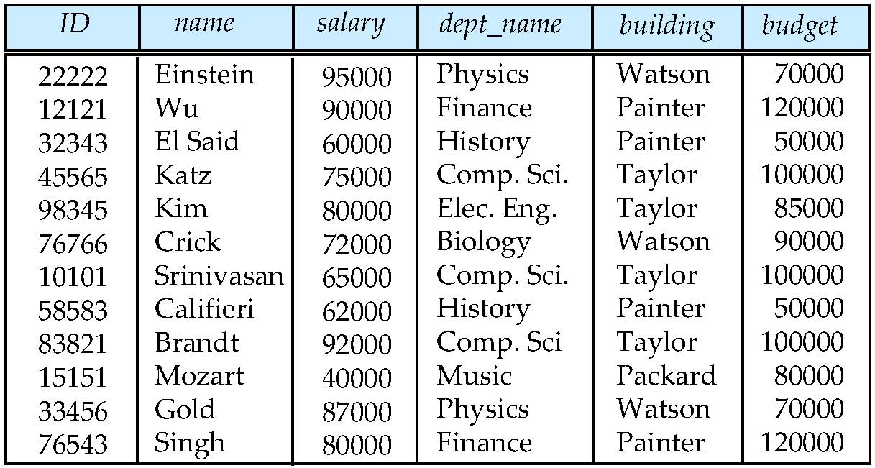
Database Design?
Is there any problem with this design?
Quiz Q2: The problem is: (1) missing information (2) repeated information (3) there is no problem (4) these instructor salaries are too low

Slide 17
Design Approaches
Normalization Theory
Formalize what designs are bad, and test for them
Entity Relationship Model
Models an enterprise as a collection of entities and relationships
Entity: a “thing” or “object” in the enterprise that is distinguishable from other objects
Described by a set of attributes
Relationship: an association among several entities
Represented diagrammatically by an entity-relationship diagram:

Slide 18
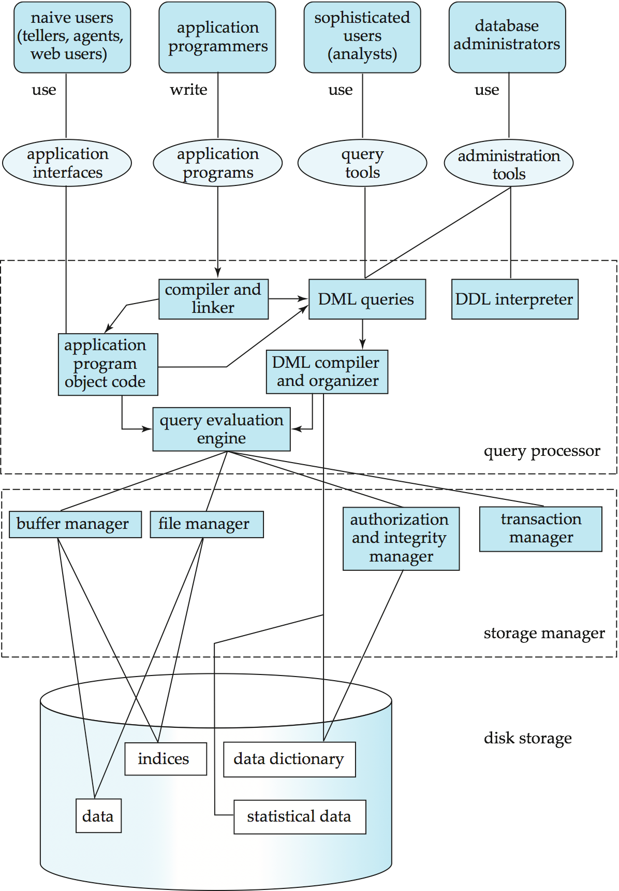
Database System Internals
Query Processor
Storage Manager
Storage
Notes:
18

Slide 19
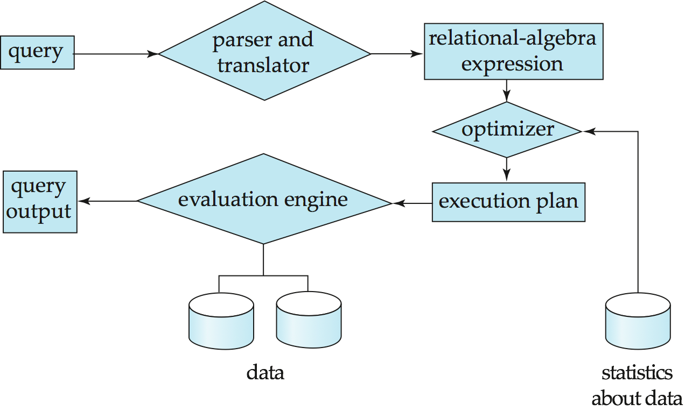
Query Processing
1. Parsing and translation
2. Optimization
3. Evaluation
Notes:
19

Slide 20
Transaction Management
A transaction is a collection of operations that performs a single logical function in a database application.
Transaction-management component ensures that the database remains in a consistent (correct) state despite system failures (e.g., power failures and operating system crashes) and transaction failures.
Concurrency-control manager controls the interaction among the concurrent transactions, to ensure the consistency of the database.
Notes:
20

Slide 21
What Is a Relational Database?
A database whose symbols are organised into a collection of relations. Here is a relation, shown in tabular form:
StudentId | Name | CourseId
S1 | Anne | C1
S1 | Anne | C2
S2 | Boris | C1
S3 | Cindy | C3
S4 | Devinder | C1
Might be the value currently assigned to ENROLMENT, a relation variable (“relvar”).

Slide 22
“Relation” not equal to “Table”
This table is different from the one we have just seen, but it represents the same relation:
Name | StudentId | CourseId
Devinder | S4 | C1
Cindy | S3 | C3
Anne | S1 | C1
Boris | S2 | C1
Anne | S1 | C2
In other words, the relation represented does not depend on the order in which we place the rows or the columns in the table.

Slide 23
Anatomy of a Relation
StudentId | Name | CourseId
S1 | Anne | C1
attribute name
attribute values
n-tuple, or tuple. This is a 3-tuple. The tuples constitute the body of the relation. The number of tuples in the body is the cardinality of the relation.
Heading (a set of attributes) The degree of this heading is 3,
which is also the degree of the relation.

Slide 24
Database Concepts
DATA MODELS
RELATIONAL MODEL - CONCEPT
Tables: In relation data model, relations are saved in the format of Tables. This format stores the relation among entities. A table has rows and columns, where rows represent records and columns represents the attributes.
Tuple: A single row of a table, which contains a single record for that relation is called a tuple.
Attribute : columns are referred as attributes.
Domain: A pool of values from which the actual values appearing in a given column are drawn.

Slide 25
Keys
Let K ⊆ R
K is a superkey of R if values for K are sufficient to identify a unique tuple of each possible relation r(R)
by “possible r ” we mean a relation r that could exist in the enterprise we are modeling.
Example: {customer_name, customer_street} and {customer_name} are both superkeys of Customer, if no two customers can possibly have the same name.
K is a candidate key if K is minimal Example: {customer_name} is a candidate key for Customer, since it is a superkey (assuming no two customers can possibly have the same name), and no subset of it is a superkey.
Primary Key

Slide 26
Database Concepts
DATA MODELS
RELATIONAL MODEL - CONCEPT
What does Primary Key mean?
A primary key is a special relational database table column (or combination of columns) designated to uniquely identify all table records.
A primary key’s main features are:
It must contain a unique value for each row of data.
It cannot contain null values.
A primary key is either an existing table column or a column that is specifically generated by the database according to a defined sequence.

Slide 27
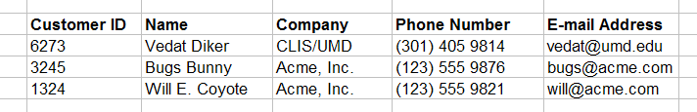
Database Concepts
DATA MODELS
RELATIONAL MODEL - CONCEPT
PRMARY KEY - TABLE - CUSTOMERS
primary key field
Primary key is a unique identifier of records in a table.
Primary key values may be generated manually or automatically.

Slide 28
Database Concepts
DATA MODELS
RELATIONAL MODEL - CONCEPT
What does Foreign Key mean?
A foreign key (REFERENTIAL INTEGRITY) is a column or group of columns in a relational database table that provides a link between data in two tables. It acts as a cross-reference between tables because it references the primary key of another table, thereby establishing a link between them.
The majority of tables in a relational database system adhere to the foreign key concept. In complex databases and data warehouses, data in a domain must be added across multiple tables, thus maintaining a relationship between them. The concept of referential integrity is derived from foreign key theory. Foreign keys and their implementation are more complex than primary keys.

Slide 29
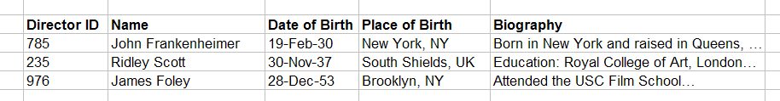
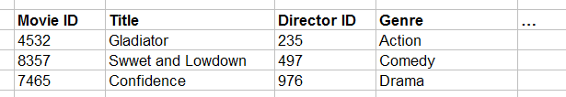
FOREIGN KEY
Primary key field
Parent table
Directors
Relationship
Movies
Child table
Foreign key field

Slide 30
Relational DB Basic Structure
Formally, given sets D₁, D₂, …. D_{n} a relation r is a subset of D₁ x D₂ x … x D_{n} Thus, a relation is a set of n-tuples (a₁, a₂, …, a_{n}) where each a_{i} ∈ D_{i}
Example: If customer_name = {Jones, Smith, Curry, Lindsay} customer_street = {Main, North, Park} customer_city = {Harrison, Rye, Pittsfield} Then r = { (Jones, Main, Harrison), (Smith, North, Rye), (Curry, North, Rye), (Lindsay, Park, Pittsfield) } is a relation over
customer_name x customer_street x customer_city

Slide 31
Attribute Types
Each attribute of a relation has a name
The set of allowed values for each attribute is called the domain of the attribute
Attribute values are (normally) required to be atomic; that is, indivisible
Note: multivalued attribute values are not atomic
Note: composite attribute values are not atomic
The special value null is a member of every domain
The null value causes complications in the definition of many operations
We shall ignore the effect of null values in our main presentation and consider their effect later

Slide 32
Relation Schema
A₁, A₂, …, A_{n} are attributes
R = (A₁, A₂, …, A_{n} ) is a relation schema
Example:
Customer_schema = (customer_name, customer_street, customer_city)
r(R) is a relation on the relation schema R
Example:
customer (Customer_schema)

Slide 33
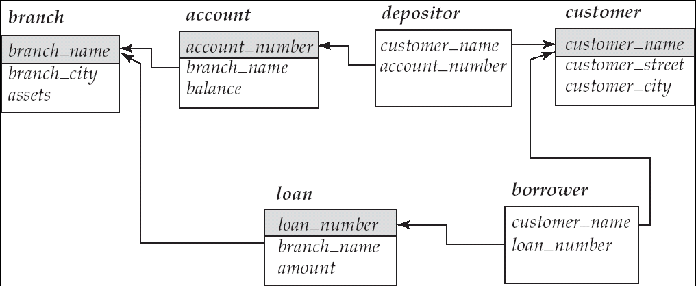
Schema diagram

Slide 34
Relation Instance
The current values (relation instance) of a relation are specified by a table
An element t of r is a tuple, represented by a row in a table
attributes
(or columns)
customer_name
customer_street
customer_city
Jones
Smith
Curry
Lindsay
Main
North
North
Park
Harrison
Rye
Rye
Pittsfield
tuples
(or rows)
customer

Slide 35
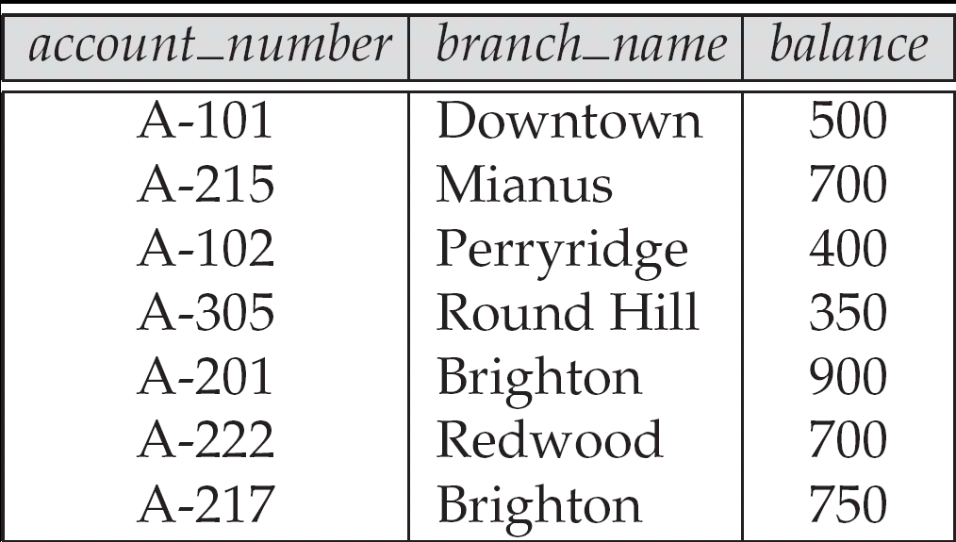
Relations are Unordered
Order of tuples is irrelevant (tuples may be stored in an arbitrary order)
Example: account relation with unordered tuples

Slide 36
Query Languages
Language in which user requests information from the database.
Categories of languages
Procedural
Non-procedural, or declarative
“Pure” languages:
Relational algebra
Tuple relational calculus
Domain relational calculus
Pure languages form underlying basis of query languages that people use.

Slide 37
Relational Algebra
Procedural language
Six basic operators
select: σ
project: ∏
union: ∪
set difference: –
Cartesian product: x
rename: ρ
The operators take one or two relations as inputs and produce a new relation as a result.

Slide 38
Select Operation – Example
Relation r
A
B
C
D
α
α
β
β
α
β
β
β
1
5
12
23
7
7
3
10
σ_{A=B ^ D > 5} (r)
A
B
C
D
α
β
α
β
1
23
7
10

Slide 39
Select Operation
Notation: σ _{p}(r)
p is called the selection predicate
Defined as: σ_{p}(r) = {t | t ∈ r and p(t)}
Where p is a formula in propositional calculus consisting of terms connected by : ∧ (and), ∨ (or), ¬ (not) Each term is one of:
<attribute> op <attribute> or <constant>
where op is one of: =, ≠, >, ≥. <. ≤
Example of selection: σ _{branch_name=“Perryridge”}(account)

Slide 40
Project Operation – Example
A
B
C
Relation r:
α
α
β
β
10
20
30
40
1
1
1
2
A
C
A
C
∏_{A,C} (r)
α
α
β
β
1
1
1
2
α
β
β
1
1
2
=

Slide 41
Project Operation
Notation:
where A₁, A₂ are attribute names and r is a relation name.
The result is defined as the relation of k columns obtained by erasing the columns that are not listed
Duplicate rows removed from result, since relations are sets
Example: To eliminate the branch_name attribute of account ∏_{account_number, balance} (account)

Slide 42
Union Operation – Example
Relations r, s:
A
B
A
B
α
α
β
1
2
1
α
β
2
3
s
r
A
B
α
α
β
β
1
2
1
3
r ∪ s:

Slide 43
Union Operation
Notation: r ∪ s
Defined as:
r ∪ s = {t | t ∈ r or t ∈ s}
For r ∪ s to be valid.
1. r, s must have the same arity (same number of attributes)
2. The attribute domains must be compatible (example: 2nd column of r deals with the same type of values as does the 2nd column of s)
Example: to find all customers with either an account or a loan ∏_{customer_name} (depositor) ∪ ∏_{customer_name} (borrower)

Slide 44
Set Difference Operation – Example
Relations r, s:
A
B
A
B
α
α
β
1
2
1
α
β
2
3
s
r
r – s:
A
B
α
β
1
1

Slide 45
Set Difference Operation
Notation r – s
Defined as:
r – s = {t | t ∈ r and t ∉ s}
Set differences must be taken between compatible relations.
r and s must have the same arity
attribute domains of r and s must be compatible

Slide 46
Cartesian-Product Operation – Example
Relations r, s:
A
B
C
D
E
α
β
1
2
α
β
β
γ
10
10
20
10
a
a
b
b
r
s
r x s:
A
B
C
D
E
α
α
α
α
β
β
β
β
1
1
1
1
2
2
2
2
α
β
β
γ
α
β
β
γ
10
10
20
10
10
10
20
10
a
a
b
b
a
a
b
b

Slide 47
Cartesian-Product Operation
Notation r x s
Defined as:
r x s = {t q | t ∈ r and q ∈ s}
Assume that attributes of r(R) and s(S) are disjoint. (That is, R ∩ S = ∅).
If attributes of r(R) and s(S) are not disjoint, then renaming must be used.

Slide 48
Composition of Operations
Can build expressions using multiple operations
Example: σ_{A=C}(r x s)
r x s
σ_{A=C}(r x s)
A
B
C
D
E
α
α
α
α
β
β
β
β
1
1
1
1
2
2
2
2
α
β
β
γ α
β
β
γ
10
10
20
10
10
10
20
10
a
a
b
b
a
a
b
b
A
B
C
D
E
α
β
β
1
2
2
α
β
β
10
10
20
a
a
b

Slide 49
Rename Operation
Allows us to name, and therefore to refer to, the results of relational-algebra expressions.
Allows us to refer to a relation by more than one name.
Example:
ρ _{x} (E)
returns the expression E under the name X
If a relational-algebra expression E has arity n, then
returns the result of expression E under the name X, and with the attributes renamed to A₁ , A₂ , …., A_{n} .

Slide 50
Banking Example
branch (branch_name, branch_city, assets)
customer (customer_name, customer_street, customer_city)
account (account_number, branch_name, balance)
loan (loan_number, branch_name, amount)
depositor (customer_name, account_number)
borrower (customer_name, loan_number)

Slide 51
Example Queries
Find all loans of over $1200
σ_{amount > 1200} (loan)
Find the loan number for each loan of an amount greater than $1200
∏_{loan_number} (σ_{amount} _{> 1200} (loan))

Slide 52
Example Queries
Find the names of all customers who have a loan, an account, or both, from the bank
∏_{customer_name} (borrower) ∪ ∏_{customer_name} (depositor)
Find the names of all customers who have a loan and an account at bank.
∏_{customer_name} (borrower) ∩ ∏_{customer_name} (depositor)

Slide 53
Example Queries
Find the names of all customers who have a loan at the Perryridge branch.
∏_{customer_name} (σ_{branch_name=“Perryridge”}
(σborrower.loan_number = loan.loan_number(borrower x loan)))
Find the names of all customers who have a loan at the Perryridge branch but do not have an account at any branch of the bank.
∏_{customer_name} (σ_{branch_name = “Perryridge”}
(σborrower.loan_number = loan.loan_number(borrower x loan))) – ∏_{customer_name}(depositor)

Slide 54
Example Queries
Find the names of all customers who have a loan at the Perryridge branch.
Query 1 ∏_{customer_name} (σ_{branch_name = “Perryridge”} ( σborrower.loan_number = loan.loan_number (borrower x loan)))
Query 2
∏_{customer_name}(σloan.loan_number = borrower.loan_number ( (σ_{branch_name = “Perryridge”} (loan)) x borrower))

Slide 55
Example Queries
Find the largest account balance
Strategy:
Find those balances that are not the largest
Rename account relation as d so that we can compare each account balance with all others
Use set difference to find those account balances that were not found in the earlier step.
The query is:
∏_{balance}(account) - ∏_{account.balance}
(σ_{account.balance < d.balance} (account x ρ_{d} (account)))

Slide 56
Formal Definition
A basic expression in the relational algebra consists of either one of the following:
A relation in the database
A constant relation
Let E₁ and E₂ be relational-algebra expressions; the following are all relational-algebra expressions:
E₁ ∪ E₂
E₁ – E₂
E₁ x E₂
σ_{p} (E₁), P is a predicate on attributes in E₁
∏_{s}(E₁), S is a list consisting of some of the attributes in E₁
ρ _{x} (E₁), x is the new name for the result of E₁

Slide 57
Additional Operations
We define additional operations that do not add any power to the relational algebra, but that simplify common queries.
Set intersection
Natural join
Division
Assignment

Slide 58
Set-Intersection Operation
Notation: r ∩ s
Defined as:
r ∩ s = { t | t ∈ r and t ∈ s }
Assume:
r, s have the same arity
attributes of r and s are compatible
Note: r ∩ s = r – (r – s)

Slide 59
Set-Intersection Operation – Example
Relation r, s:
r ∩ s
A B
A B
α
α
β
1
2
1
α
β
2
3
r
s
A B
α 2

Slide 60
Natural-Join Operation
Notation: r s
Let r and s be relations on schemas R and S respectively. Then, r s is a relation on schema R ∪ S obtained as follows:
Consider each pair of tuples t_{r} from r and t_{s} from s.
If t_{r} and t_{s} have the same value on each of the attributes in R ∩ S, add a tuple t to the result, where
t has the same value as t_{r} on r
t has the same value as t_{s} on s
Example:
R = (A, B, C, D)
S = (E, B, D)
Result schema = (A, B, C, D, E)
r s is defined as: ∏_{r.A, r.B, r.C, r.D, s.E} (σ_{r.B = s.B} ∧ _{r.D = s.D} (r x s))

Slide 61
Natural Join Operation – Example
Relations r, s:
A
B
C
D
B
D
E
α
β
γ
α
δ
1
2
4
1
2
α
γ
β
γ
β
a
a
b
a
b
1
3
1
2
3
a
a
a
b
b
α
β
γ
δ
∈
r
s
r s
A
B
C
D
E
α
α
α
α
δ
1
1
1
1
2
α
α
γ
γ
β
a
a
a
a
b
α
γ
α
γ
δ

Slide 62
Division Operation
r ÷ s
Notation:
Suited to queries that include the phrase “for all”.
Let r and s be relations on schemas R and S respectively where
R = (A₁, …, A_{m} , B₁, …, B_{n} )
S = (B₁, …, B_{n})
The result of r ÷ s is a relation on schema
R – S = (A₁, …, A_{m})
r ÷ s = { t | t ∈ ∏ _{R-S} (r) ∧ ∀ u ∈ s ( tu ∈ r ) }
Where tu means the concatenation of tuples t and u to produce a single tuple

Slide 63
Division Operation – Example
Relations r, s:
A
B
B
α
α
α
β
γ
δ
δ
δ
∈
∈
β
1
2
3
1
1
1
3
4
6
1
2
1
2
s
r ÷ s:
A
r
α
β

Slide 64
Another Division Example
Relations r, s:
A
B
C
D
E
D
E
α
α
α
β
β
γ
γ
γ
a
a
a
a
a
a
a
a
α
γ
γ
γ
γ
γ
γ
β
a
a
b
a
b
a
b
b
1
1
1
1
3
1
1
1
a
b
1
1
s
r
r ÷ s:
A
B
C
α
γ
a
a
γ
γ

Slide 65
Division Operation (Cont.)
Property
Let q = r ÷ s
Then q is the largest relation satisfying q x s ⊆ r
Definition in terms of the basic algebra operation Let r(R) and s(S) be relations, and let S ⊆ R
r ÷ s = ∏_{R-S} (r ) – ∏_{R-S} ( ( ∏_{R-S} (r ) x s ) – ∏_{R-S,S}(r ))
To see why
∏_{R-S,S} (r) simply reorders attributes of r
∏_{R-S} (∏_{R-S} (r ) x s ) – ∏_{R-S,S}(r) ) gives those tuples t in ∏_{R-S} (r ) such that for some tuple u ∈ s, tu ∉ r.

Slide 66
Assignment Operation
The assignment operation (←) provides a convenient way to express complex queries.
Write query as a sequential program consisting of
a series of assignments
followed by an expression whose value is displayed as a result of the query.
Assignment must always be made to a temporary relation variable.
Example: Write r ÷ s as
temp1 ← ∏_{R-S} (r ) temp2 ← ∏_{R-S} ((temp1 x s ) – ∏_{R-S,S} (r )) result = temp1 – temp2
The result to the right of the ← is assigned to the relation variable on the left of the ←.
May use variable in subsequent expressions.

Slide 67
Bank Example Queries
Find the names of all customers who have a loan and an account at bank.
∏_{customer_name} (borrower) ∩ ∏_{customer_name} (depositor)
Find the name of all customers who have a loan at the bank and the loan amount

Slide 68
Bank Example Queries
Find all customers who have an account from at least the “Downtown” and the Uptown” branches.
Query 1
∏_{customer_name} (σ_{branch_name = “Downtown”} (depositor account )) ∩
∏_{customer_name} (σ_{branch_name = “Uptown”} (depositor account))
Query 2
∏_{customer_name, branch_name} (depositor account) ÷ ρ_{temp(branch_name)} ({(“Downtown” ), (“Uptown” )})
Note that Query 2 uses a constant relation.

Slide 69
Example Queries
Find all customers who have an account at all branches located in Brooklyn city.
∏_{customer_name, branch_name} (depositor account) ÷ ∏_{branch_name} (σ_{branch_city = “Brooklyn”} (branch))

Slide 70
Extended Relational-Algebra-Operations
Generalized Projection
Aggregate Functions
Outer Join

Slide 71
Generalized Projection
Extends the projection operation by allowing arithmetic functions to be used in the projection list.
E is any relational-algebra expression
Each of F₁, F₂, …, F_{n} are are arithmetic expressions involving constants and attributes in the schema of E.
Given relation credit_info(customer_name, limit, credit_balance), find how much more each person can spend:
∏customer_name, limit – credit_balance (credit_info)

Slide 72
Aggregate Functions and Operations
Aggregation function takes a collection of values and returns a single value as a result.
avg: average value min: minimum value max: maximum value sum: sum of values count: number of values
Aggregate operation in relational algebra
E is any relational-algebra expression
G₁, G₂ …, G_{n} is a list of attributes on which to group (can be empty)
Each F_{i} is an aggregate function
Each A_{i} is an attribute name

Slide 73
Aggregate Operation – Example
Relation r:
A
B
C
α
α
β
β
α
β
β
β
7
7
3
10
g _{sum(c)} (r)
sum(c )
27

Slide 74
Aggregate Operation – Example
Relation account grouped by branch-name:
branch_name
account_number
balance
Perryridge
Perryridge
Brighton
Brighton
Redwood
A-102
A-201
A-217
A-215
A-222
400
900
750
750
700
_{branch_name} g _{sum(balance)} (account)
branch_name
sum(balance)
Perryridge
Brighton
Redwood
1300
1500
700

Slide 75
Aggregate Functions (Cont.)
Result of aggregation does not have a name
Can use rename operation to give it a name
For convenience, we permit renaming as part of aggregate operation
_{branch_name} g _{sum(balance) as sum_balance} (account)

Slide 76
Outer Join
An extension of the join operation that avoids loss of information.
Computes the join and then adds tuples form one relation that does not match tuples in the other relation to the result of the join.
Uses null values:
null signifies that the value is unknown or does not exist
All comparisons involving null are (roughly speaking) false by definition.
We shall study precise meaning of comparisons with nulls later

Slide 77
Outer Join – Example
Relation loan
loan_number
branch_name
amount
L-170
L-230
L-260
Downtown
Redwood
Perryridge
3000
4000
1700
Relation borrower
customer_name
loan_number
Jones
Smith
Hayes
L-170
L-230
L-155

Slide 78
Outer Join – Example
Inner Join loan Borrower
loan_number
branch_name
amount
customer_name
L-170
L-230
Downtown
Redwood
3000
4000
Jones
Smith
Left Outer Join
loan Borrower
loan_number
branch_name
amount
customer_name
L-170
L-230
L-260
Downtown
Redwood
Perryridge
3000
4000
1700
Jones
Smith
null

Slide 79
Outer Join – Example
Right Outer Join
loan borrower
loan_number
branch_name
amount
customer_name
L-170
L-230
L-155
Downtown
Redwood
null
3000
4000
null
Jones
Smith
Hayes
Full Outer Join
loan borrower
loan_number
branch_name
amount
customer_name
L-170
L-230
L-260
L-155
Downtown
Redwood
Perryridge
null
3000
4000
1700
null
Jones
Smith
null
Hayes

Slide 80
Null Values
It is possible for tuples to have a null value, denoted by null, for some of their attributes
null signifies an unknown value or that a value does not exist.
The result of any arithmetic expression involving null is null.
Aggregate functions simply ignore null values (as in SQL)
For duplicate elimination and grouping, null is treated like any other value, and two nulls are assumed to be the same (as in SQL)

Slide 81
Null Values
Comparisons with null values return the special truth value: unknown
If false was used instead of unknown, then not (A < 5) would not be equivalent to A >= 5
Three-valued logic using the truth value unknown:
OR: (unknown or true) = true, (unknown or false) = unknown (unknown or unknown) = unknown
AND: (true and unknown) = unknown, (false and unknown) = false, (unknown and unknown) = unknown
NOT: (not unknown) = unknown
In SQL “P is unknown” evaluates to true if predicate P evaluates to unknown
Result of select predicate is treated as false if it evaluates to unknown

Slide 82
Modification of the Database
The content of the database may be modified using the following operations:
Deletion
Insertion
Updating
All these operations are expressed using the assignment operator.

Slide 83
Deletion
A delete request is expressed similarly to a query, except instead of displaying tuples to the user, the selected tuples are removed from the database.
Can delete only whole tuples; cannot delete values on only particular attributes
A deletion is expressed in relational algebra by:
r ← r – E
where r is a relation and E is a relational algebra query.

Slide 84
Deletion Examples
Delete all account records in the Perryridge branch.
account ← account – σ _{branch_name = “Perryridge”} (account )
Delete all loan records with amount in the range of 0 to 50
loan ← loan – σ _{amount ≥ 0 and amount ≤ 50} (loan)
Delete all accounts at branches located in Needham.
r₁ ← σ _{branch_city = “Needham”} (account branch )
r₂ ← ∏branch_name, account_number, balance (r₁)
r₃ ← ∏ _{customer_name, account_number} (r₂ depositor)
account ← account – r₂
depositor ← depositor – r₃

Slide 85
Insertion
To insert data into a relation, we either:
specify a tuple to be inserted
write a query whose result is a set of tuples to be inserted
in relational algebra, an insertion is expressed by:
r ← r ∪ E
where r is a relation and E is a relational algebra expression.
The insertion of a single tuple is expressed by letting E be a constant relation containing one tuple.

Slide 86
Insertion Examples
Insert information in the database specifying that Smith has $1200 in account A-973 at the Perryridge branch.
account ← account ∪ {(“Perryridge”, A-973, 1200)}
depositor ← depositor ∪ {(“Smith”, A-973)}
Provide as a gift for all loan customers in the Perryridge branch, a $200 savings account. Let the loan number serve as the account number for the new savings account.
r₁ ← (σ_{branch_name = “Perryridge”} (borrower loan))
account ← account ∪ ∏_{branch_name, loan_number,200} (r₁)
depositor ← depositor ∪ ∏_{customer_name, loan_number} (r₁)

Slide 87
Updating
A mechanism to change a value in a tuple without charging all values in the tuple
Use the generalized projection operator to do this task
Each F_{i} is either
the I ^{th} attribute of r, if the I ^{th} attribute is not updated, or,
if the attribute is to be updated F_{i} is an expression, involving only constants and the attributes of r, which gives the new value for the attribute

Slide 88
Update Examples
Make interest payments by increasing all balances by 5 percent.
account ← ∏ account_number, branch_name, balance * 1.05 (account)
Pay all accounts with balances over $10,000 6 percent interest and pay all others 5 percent
account ← ∏ account_number, branch_name, balance * 1.06 (σ _{BAL > 10000} (account )) ∪ ∏ account_number, branch_name, balance * 1.05 (σ_{BAL ≤ 10000} (account))

Slide 89
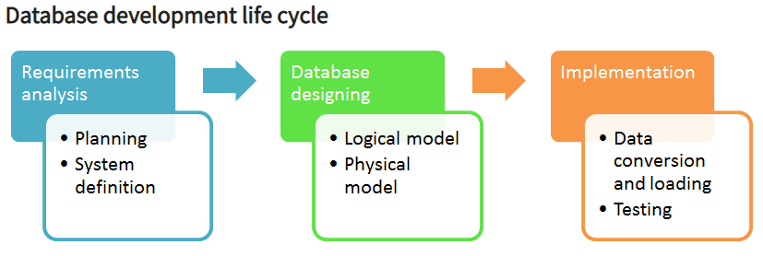
Design process
Database Design is a collection of processes that facilitate the designing, development, implementation and maintenance of enterprise data management systems. Properly designed database are easy to maintain, improves data consistency and are cost effective in terms of disk storage space.

Slide 90
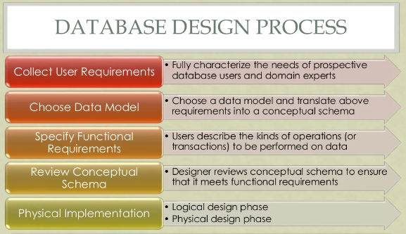

Slide 91
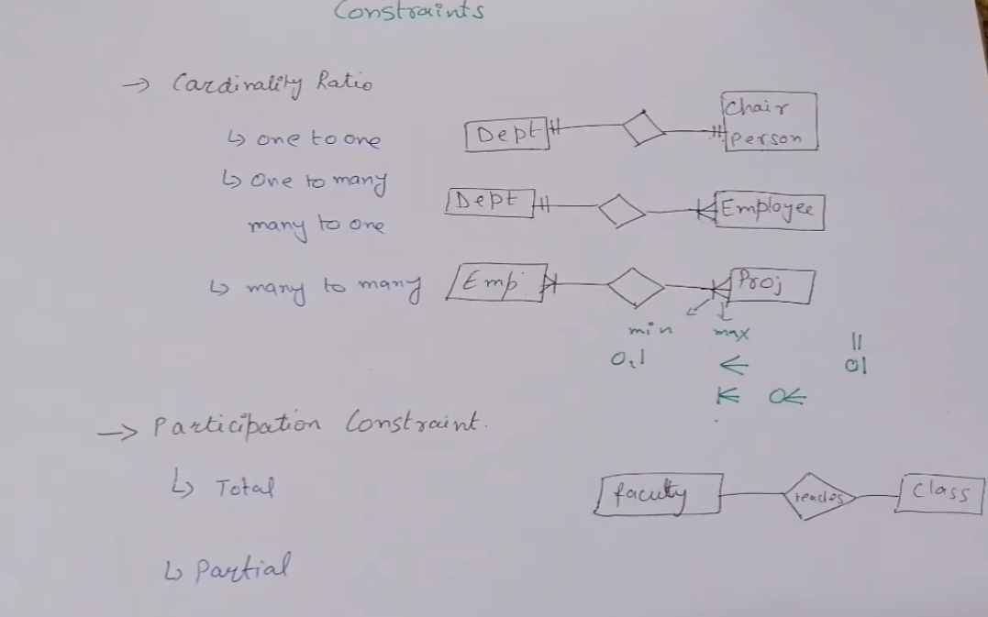

Slide 92
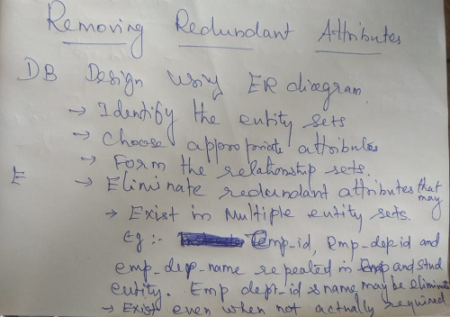

Slide 93
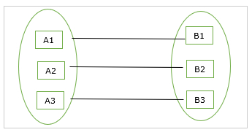
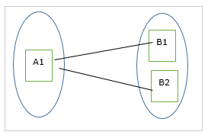
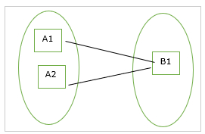
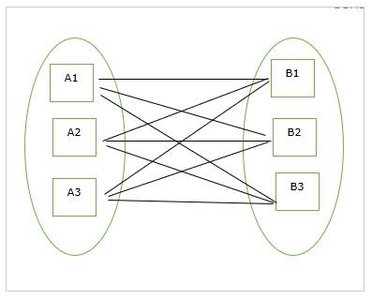

Slide 94
Design Steps
Identify
Entity types, relationship types
Cardinality and participation constraints
Attributes
Keys
Specialize/generalize
EER diagram
EER model example

Slide 95
Characteristics of E-R Model
Semantic data model
Express the logical properties of an enterprise database
Design tools and documentation for data base structure
No physical DBMS
Proposed by Dr. Peter Chen
Unified Modeling Language (UML)

Slide 96
Components of E-R Model
Entity
Attribute
Key
Relationship
Structural constraints on relationship

Slide 97
Entity
Definition
An object or concept
Types
Strong entity (parent, owner, dominant)
Weak entity (child, dependent, or subordinate)

Slide 98
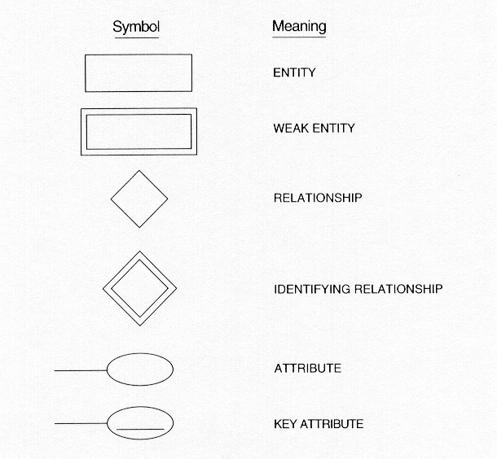

Slide 99
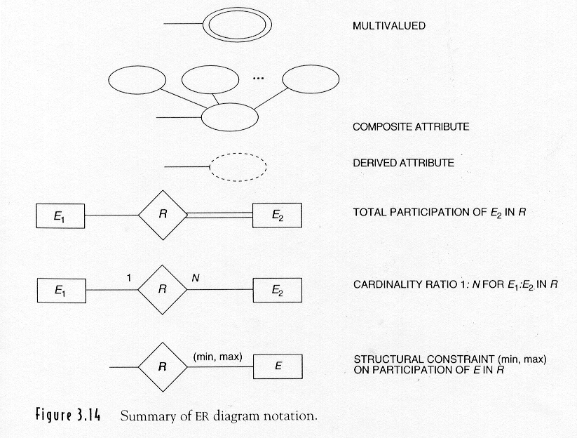

Slide 100
Attribute
Domain
Types
Single
Composite
Single-valued
Multi-valued
Derived

Slide 101
Key
Candidate key
Primary key
Composite key

Slide 102
Relationship
Definition
Association among entities
Diagram Notation
Line – (relation or role name)
Degree of a relationship
Number of participating entities
Types
Unary (recursive relationship)
Binary
Ternary
Quaternary

Slide 103
Structural Constraints on Relationship
Cardinality constraints
Zero-to-one 0..1
Zero-to-many 0..*
One-to-many 1..*
Many-to-many *..*
Participation constraints
Total (mandatory, every one involved)
Partial (optional, only some involved)

Slide 104
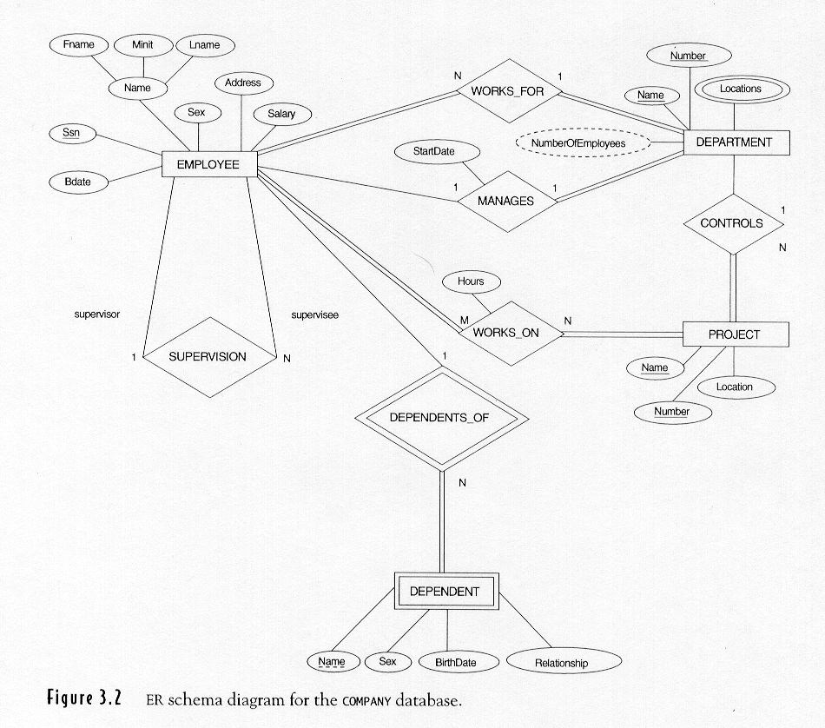

Slide 105
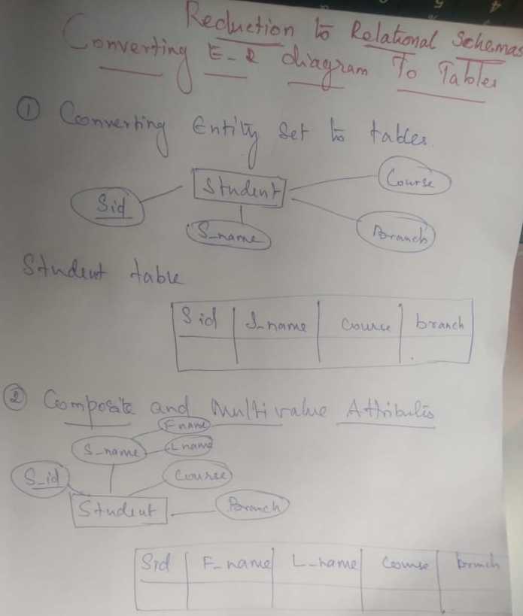

Slide 106
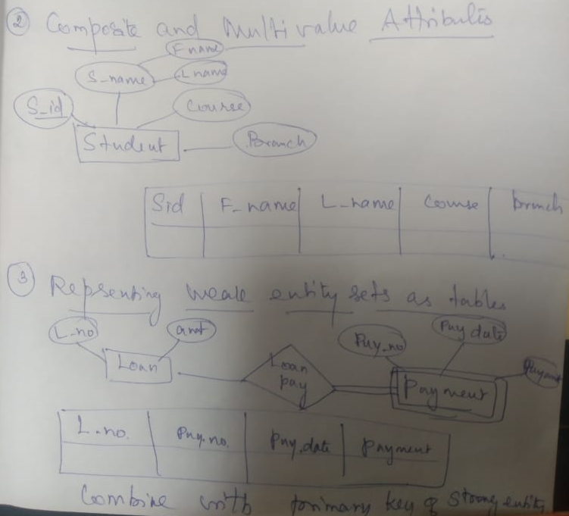

Slide 107
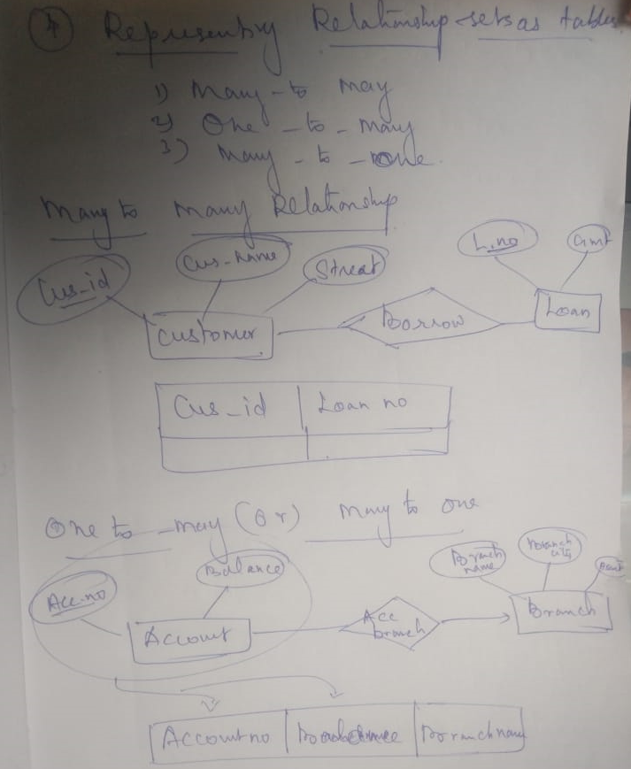

Slide 108
Design Issues
Use of entity sets vs. attributes Choice mainly depends on the structure of the enterprise being modeled, and on the semantics associated with the attribute in question.
Use of entity sets vs. relationship sets Possible guideline is to designate a relationship set to describe an action that occurs between entities
Binary versus n-ary relationship sets Although it is possible to replace any nonbinary (n-ary, for n > 2) relationship set by a number of distinct binary relationship sets, a n-ary relationship set shows more clearly that several entities participate in a single relationship.
Placement of relationship attributes

Slide 109
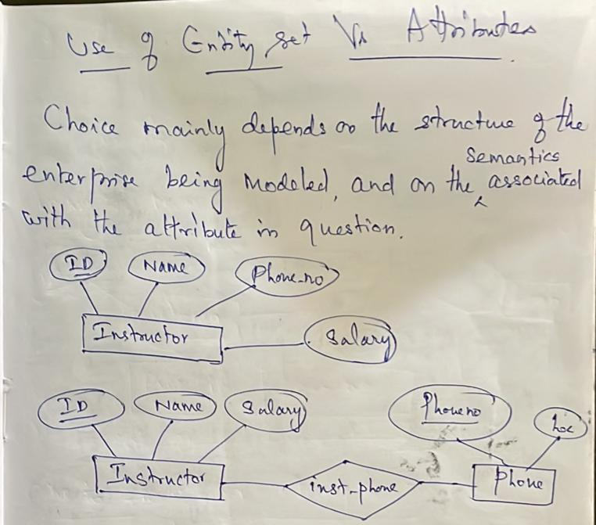

Slide 110
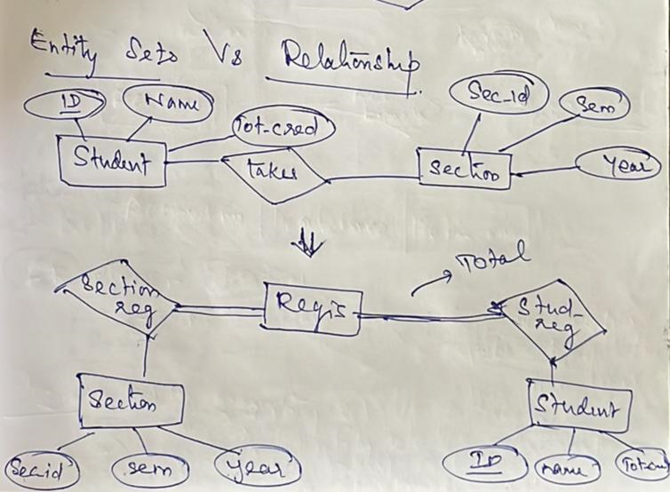

Slide 111
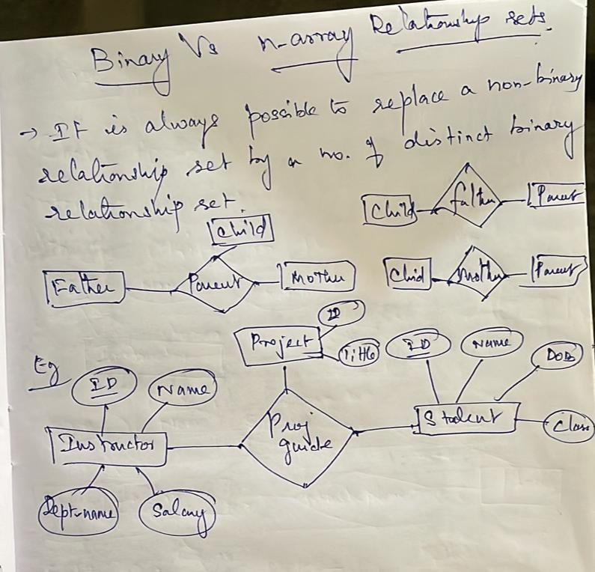

Slide 112
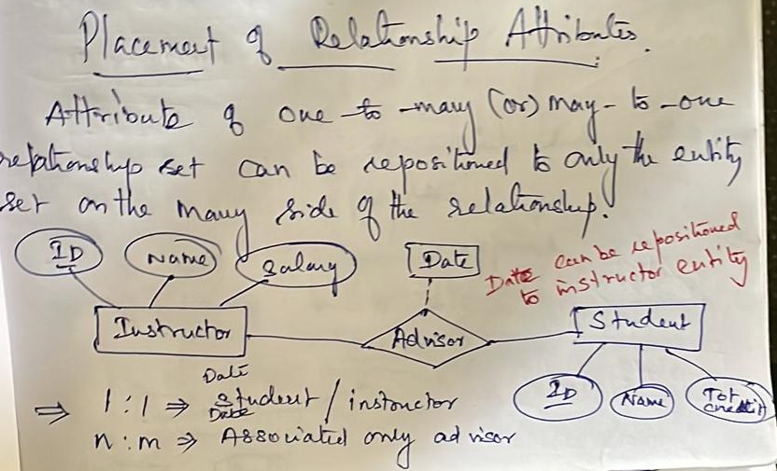

Slide 113
Weak Entity Sets
An entity set that does not have a primary key is referred to as a weak entity set.
The existence of a weak entity set depends on the existence of a identifying entity set
it must relate to the identifying entity set via a total, one-to-many relationship set from the identifying to the weak entity set
Identifying relationship depicted using a double diamond

Slide 114
Weak entity …
The discriminator (or partial key) of a weak entity set is the set of attributes that distinguishes among all the entities of a weak entity set.
The primary key of a weak entity set is formed by the primary key of the strong entity set on which the weak entity set is existence dependent, plus the weak entity set’s discriminator.

Slide 115
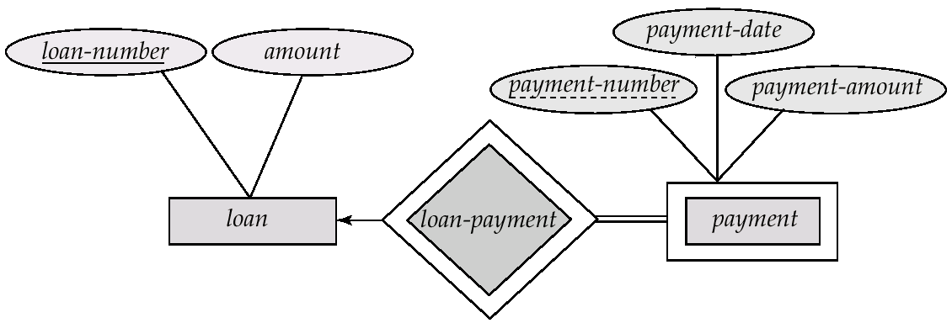
Weak Entity Sets (Cont.)
Notation : see figure
payment-number – discriminator of the payment entity set
Primary key for payment – (loan-number, payment-number)

Slide 116
EXTENDED E-R MODEL
extensions to capture more meaning
concepts of generalization, aggregation and sub-set hierarchies added
Similar to OO concepts : inheritance, composite objects

Slide 117
Generalization
to generalize from two or more entity sets and factor out commonality
Example : given two entities Faculty and Non-faculty, we can define a ‘general’ entity called Employee
Common attributes are factored out to define ‘Employee’ entity; specific (non-common) attributes incorporated in ‘Faculty’ and ‘Non-faculty’ entities
Also called as IS-A relationship
A bottom-up design process – combine a number of entity sets that share the same features into a higher-level entity set.

Slide 118
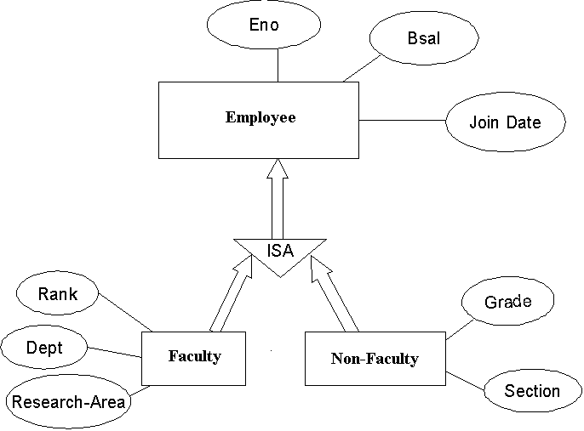

Slide 119
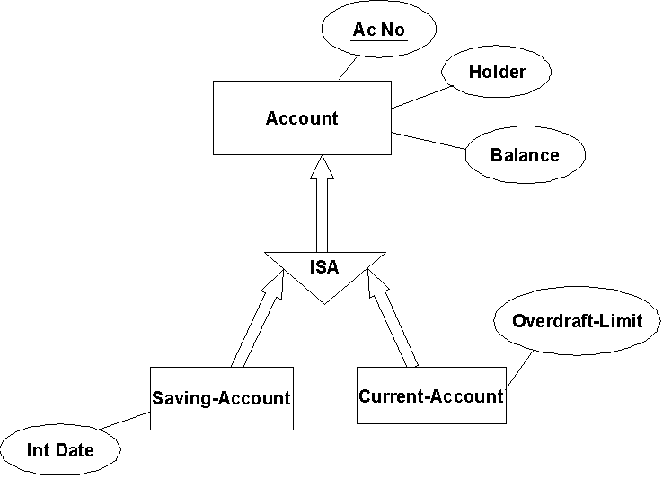
Another example :

Slide 120
Specialization
also called subset hierarchy; we create special cases for a given entity
Teacher as a special case of Employee
entity E1 is subset of E if every instance of E1 is also an instance of E; this is also IS-A relationship
every instance in E need not be present in subsets of E
E called superset and E1 as subset (or sub-class

Slide 121
Specialization…..
specialization allows classification of an entity into subsets based on some distinguishing attribute/property
we may have several specialization of same entity
the subsets may have additional attributes

Slide 122
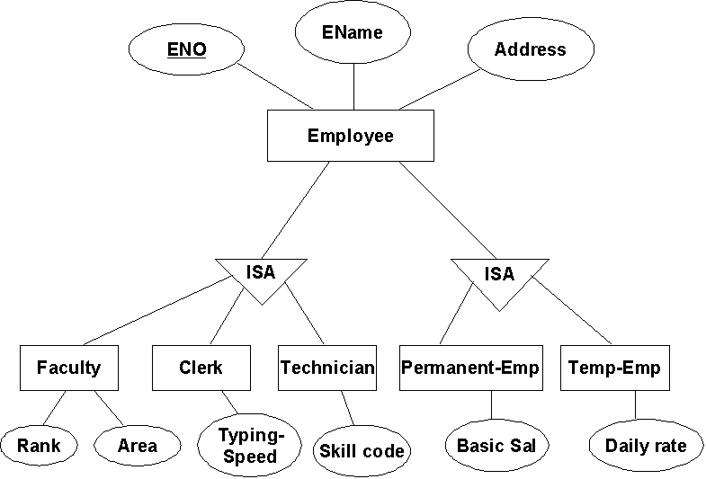

Slide 123
Specialization
Top-down design process; we designate subgroupings within an entity set that are distinctive from other entities in the set.
These subgroupings become lower-level entity sets that have attributes or participate in relationships that do not apply to the higher-level entity set.
Depicted by a triangle component labeled ISA (E.g. customer “is a” person).

Slide 124
Inheritance
there is inheritance of attributes from superclass or superset
the subclass/subset automatically inherits attributes defined at superclass/superset level
They also inherit relationship participations of higher levels
thus, inheritance present in both Generalization and specialization
Direction important : bottom-up in generalization, top-down in Specialization
Important to distinguish the two cases

Slide 125
UML
UML: Unified Modeling Language
UML has many components to graphically model different aspects of an entire software system
UML Class Diagrams correspond to E-R Diagram, but several differences.

Slide 126
Requirements Modeling
Use Case Diagram
Activity Diagram

Slide 127
Use Case Diagram
Used for describing a set of user scenarios
Mainly used for capturing user requirements
Works like a contract between end user and software developers

Slide 128
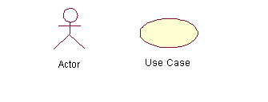
Use Case Diagram (core components)
Actors: A role that a user plays with respect to the system,including human users and other systems. e.g.,inanimate physical objects (e.g. robot); an external system that needs some information from the current system.
Use case: A set of scenarios that describes an interaction between a user and a system, including alternatives.
System boundary: rectangle diagram representing the boundary between the actors and the system.

Slide 129
Use Case Diagram(core relationship)
Association: communication between an actor and a use case; Represented by a solid line.
Generalization: relationship between one general use case and a special use case (used for defining special alternatives)
Represented by a line with a triangular arrow head toward the parent use case.

Slide 130
Use Case Diagram(core relationship)
Include: a dotted line labeled <<include>> beginning at base use case and ending with an arrows pointing to the include use case. The include relationship occurs when a chunk of behavior is similar across more than one use case. Use “include” in stead of copying the description of that behavior.
<<include>>
Extend: a dotted line labeled <<extend>> with an arrow toward the base case. The extending use case may add behavior to the base use case. The base class may declare “extension points”.
<<extend>>

Slide 132
Activity Diagram
The workflow of a use case is described using activity diagram

Slide 133
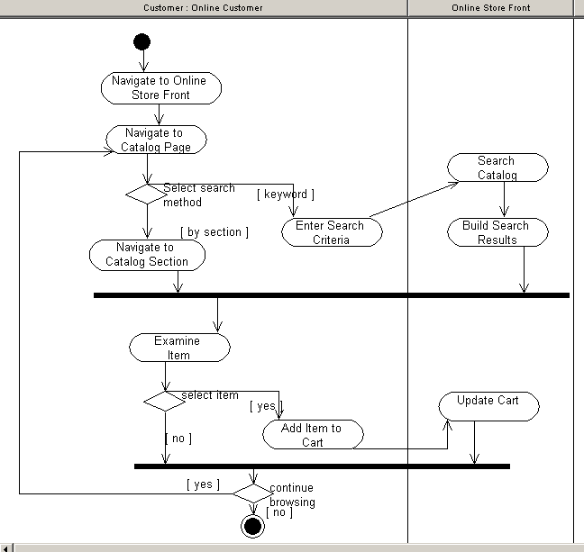
Activity Diagram – e Commerce System

Slide 134
System Modeling
Structural Models
Class Diagram
Behavioral Models
Interaction Diagram (Sequence, Collaboration)
State Chart Diagram

Slide 135
Class Diagram
Backbone of almost every object-oriented system model
Describes the static structure of a system
Provide a conceptual model of the system in terms of entities and their relationships

Slide 136
Class
Each class is represented by a rectangle subdivided into three compartments
Name
Attributes
Operations
Modifiers are used to indicate visibility of attributes and operations.
‘+’ is used to denote Public visibility (everyone)
‘#’ is used to denote Protected visibility (friends and derived)
‘-’ is used to denote Private visibility (no one)
By default, attributes are hidden and operations are visible.
The last two compartments may be omitted to simplify the class diagrams

Slide 137
Class Diagram (Relationships)
There are two kinds of Relationship
Generalization (parent-child relationship)
Association (student enrolls in course)
Associations can be further classified as
Aggregation
Composition

Slide 138
An example of Class
Name
Account_Name
- Custom_Name
- Balance
Attributes
+AddFunds( )
+WithDraw( )
+Transfer( )
Operations

Slide 139
Association Relationship
Association is the most common relationship in a class diagram
Association shows relationship between instances of the classes
Association could have
Name
End Names (Roles)
Multiplicity
Navigability
Association Name
Role
Navigable
Multiplicity

Slide 140
Multiplicity and Roles
Multiplicity
Role
student
1
*
University
Person
Multiplicity
Symbol Meaning
1 One and only one
0..1 Zero or one
M..N From M to N (natural language)
* From zero to any positive integer
0..* From zero to any positive integer
1..* From one to any positive integer
Role
A given student belongs to a single university;
An university can have zero to any number of students

Slide 141
Whole – Part Relationship
Association shows structural relationship between two classes, conceptually at peer level (Employee works for Employer)
Sometimes the relationship could be “whole-part” or “has” (e.g. A car has engine, A Company has Departments)
This is represented using aggregation or composition

Slide 142
Class Relationships: Aggregation
Container Class
Class C
Aggregation: expresses a relationship among instances
of related classes. It is a specific kind of Container-Containee relationship.
It expresses a relationship where an instance of the Container-class has the responsibility to hold and maintain instances of each Containee-class that have been created outside the auspices of the Container-class. Aggregation should be used to express a more informal relationship than composition expresses. That is, it is an appropriate relationship where the Container and its Containees can be manipulated independently.
Aggregation is appropriate when Container and Containees have no special access privileges to each other.
AGGREGATION
Class E₁
Class E₂
Containee Classes
Example
Bag
Apples
Milk

Slide 143
Class Relationships: Composition
COMPOSITION
Composition: expresses a relationship among instances
of related classes. It is a specific kind of Whole-Part relationship.
It expresses a relationship where an instance of the Whole-class has the responsibility to create and initialize instances of each Part-class. It may also be used to express a relationship where instances of the Part-classes have privileged access or visibility to certain attributes and/or behaviors defined by the Whole-class. Composition should also be used to express relationship where instances of the Whole-class have exclusive access to and control of instances of the Part-classes.
Composition should be used to express a relationship where the behavior of Part instances is undefined without being related to an instance of the Whole. And, conversely, the
behavior of the Whole is ill-defined or incomplete if one or more of the Part instances are undefined.
Whole Class
Class W
Class P₁
Class P₂
Part Classes
Example
Automobile
Engine
Transmission

Slide 144
Class Relationships: Generalization
Generalized
Class
Supertype
Example:
Customer
Regular
Customer
Loyalty
Customer
Subtype1
Subtype2
Specialized
Class
or:
Customer
Generalization expresses a relationship among related classes. It is a class that includes its subclasses.
Regular
Customer
Loyalty
Customer

Slide 145
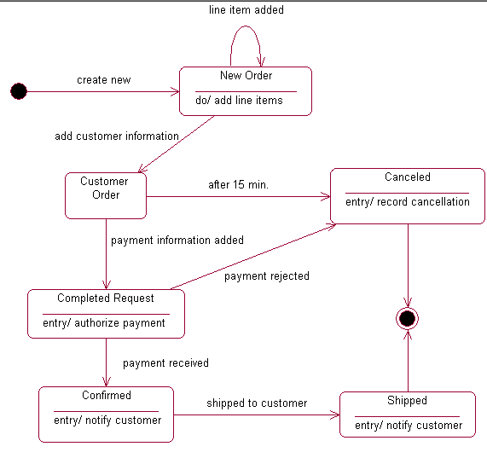
State Chart Diagram

